Slide 1
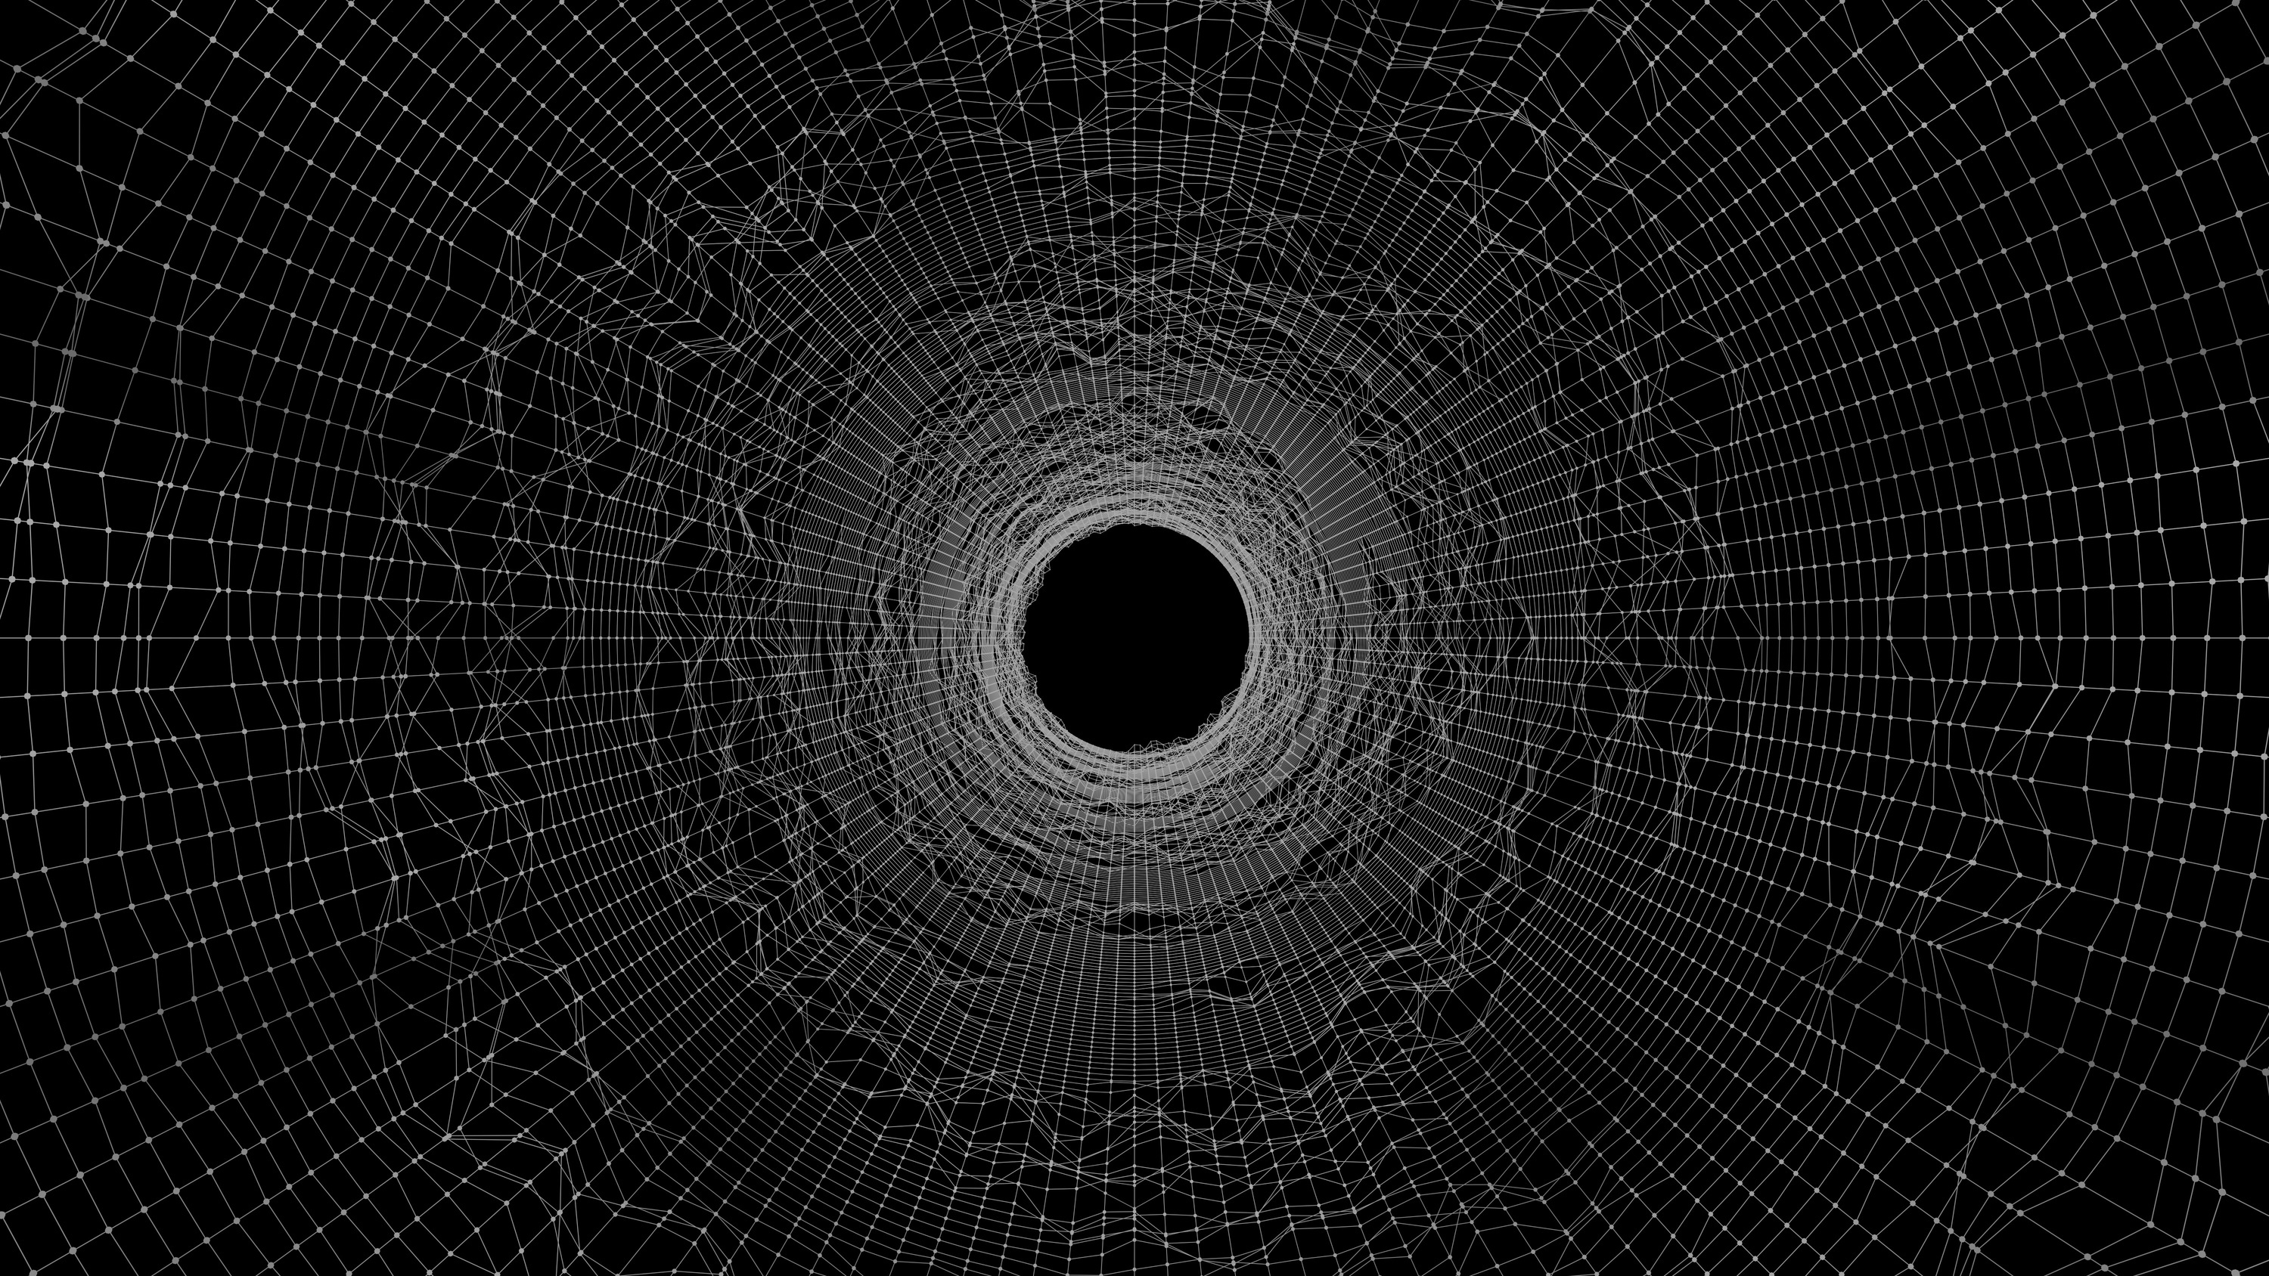






Discovering Unstructured Data!
Sanil KUMAR
TOC Co-Chair, SODA Foundation | Founder CEO, Caze Labs
LinkedIn: sanilkumard
“Data First, What Next?”
Systems & Software Conclave, IEEE Computer Science Week 2023
In Collaboration with SODA Foundation
30th Nov 2023, Ericsson, Bangalore

Slide 2

IMMERSED IN DATA...
Notes:
Creative common license:
https://cdn.pixabay.com/photo/2020/02/03/20/49/technology-4816658_1280.jpg

Slide 3
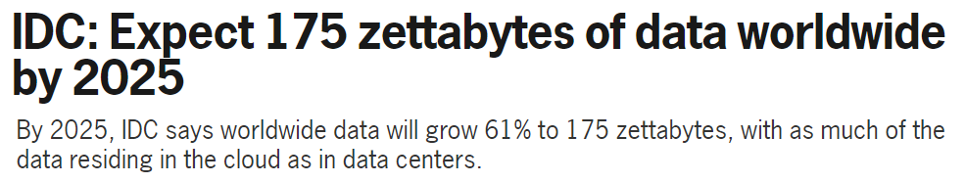
EXPLOSION OF
DATA…
2023 : 120 ZB
2025 : 181 ZB
https://www.statista.com/
1 ZB = 1000⁷bytes = 10²¹bytes = 1000000000000000000000bytes = 1000exabytes
Notes:
https://www.networkworld.com/article/3325397/idc-expect-175-zettabytes-of-data-worldwide-by-2025.html
https://www.statista.com/statistics/871513/worldwide-data-created
https://www.forbes.com/sites/forbestechcouncil/2022/02/03/the-unseen-data-conundrum/?sh=202d519a7fcc

Slide 4
DYNAMIC
TECHNOLOGY CONTEXT!
80%
Adopt Multicloud
Leverage Multicloud Strategy

Slide 5
DYNAMIC
TECHNOLOGY CONTEXT!
LLM
Huge impact of Generative AI
GPT-3 and GPT-4
Vector Databases
Data Mesh

Slide 6
DYNAMIC
TECHNOLOGY CONTEXT!
125%
$4.35M
39%
Cyber Security Attacks increased
Average Data Breach Cost
Internet users attacked (avg) globally in 2022

Slide 7
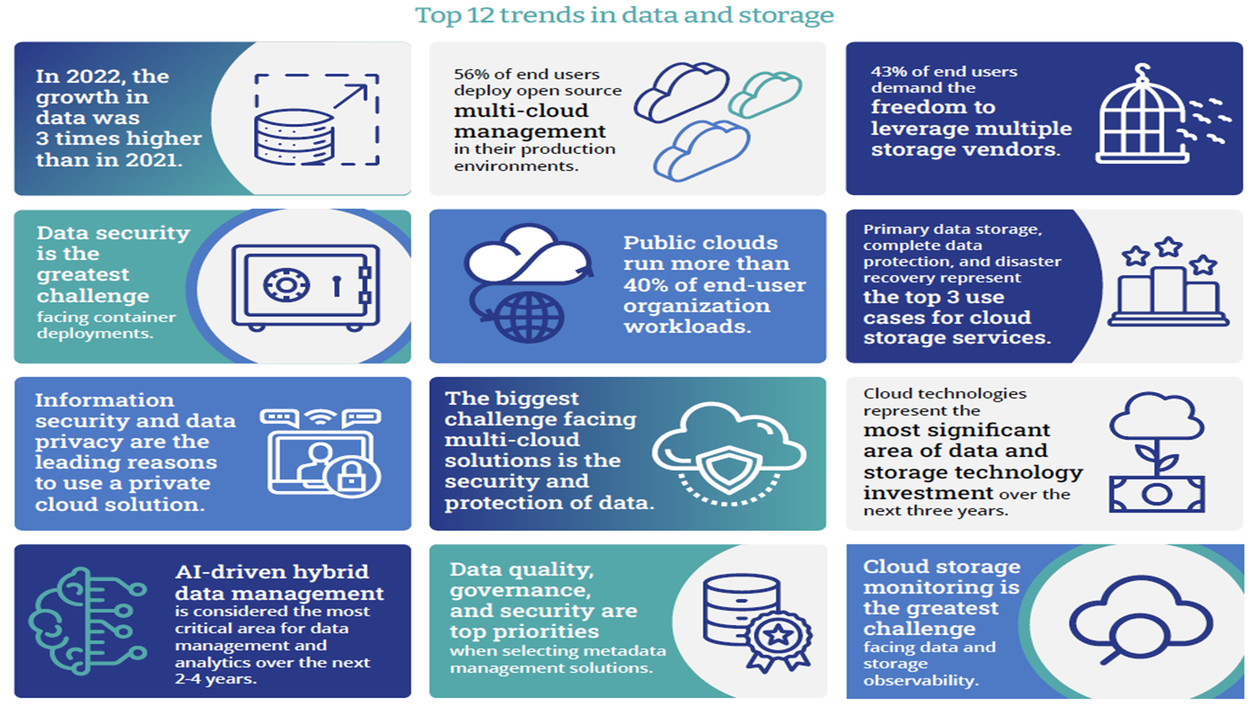


Cloud
Cloud
Cloud
Notes:
This Photo by Unknown Author is licensed under CC BY-SA
(brain one)

Slide 8



Multicloud
AI
Security
Data across multiple clouds
Hybrid Data Management
Cost and QoS
Analytics and Inference
Data Management Efficiency
Visualization
Data Privacy
Data Confidentiality
Data Integrity

Slide 9
EXPLOSION OF
DATA…
UNSTRUCTURED
with 80% of that data being unstructured!
90% of it is NEVER analyzed!
Notes:
https://www.forbes.com/sites/forbestechcouncil/2022/02/03/the-unseen-data-conundrum/?sh=202d519a7fcc

Slide 10


STRUCTURED
UNSTRUCTURED
Organized
Not Organized
Formatted
Not Formatted
Schema
No Schema
Notes:
https://www.forbes.com/sites/forbestechcouncil/2022/02/03/the-unseen-data-conundrum/?sh=202d519a7fcc

Slide 11
DARK DATA
Gartner defines dark data as the information assets organizations collect, process and store during regular business activities, but generally fail to use for other purposes (for example, analytics, business relationships and direct monetizing).
typically unstructured or semi-structured
kind of invisible, not part of decision making
Notes:
https://www.gartner.com/en/information-technology/glossary/dark-data

Slide 12
UNSTRUCTRED DATA MANGEMENT
Challenges
Scattered and Invisible
Privacy Concerns
Not compatible, so lack of tools
Silos
Distributed trend

Slide 13
UNSTRUCTRED DATA MANGEMENT
State forward:
AI / ML
Cloud based Data Management
Data Catalogs and Metadata management
Changing Privacy Situation (Tech for anonymization & differential privacy, compliance, governance)
Edge Computing
Blockchain
Storage advancements (dedup, compression, tiered storage)
...

Slide 14
What are we doing at The SODA Foundation?
Research, Industry Analysis and Crystal

Slide 15
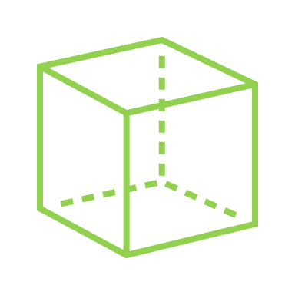
ABSTRACT DATA SILO COMPLEXITY SIMPLIFY DATA DISCOVERY
CRYSTAL
Unified View Of Data
Unified metadata for unstructured data across on-premise and cloud storage

Slide 16
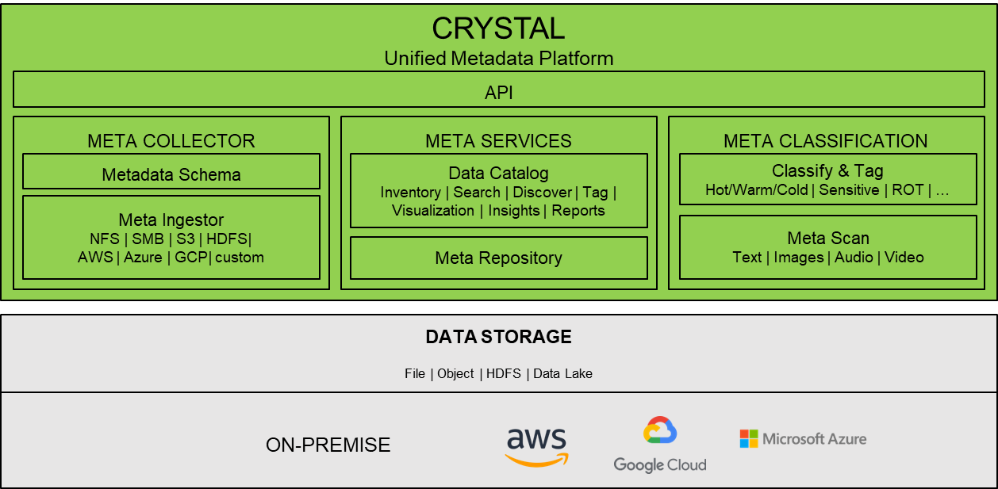

Slide 17
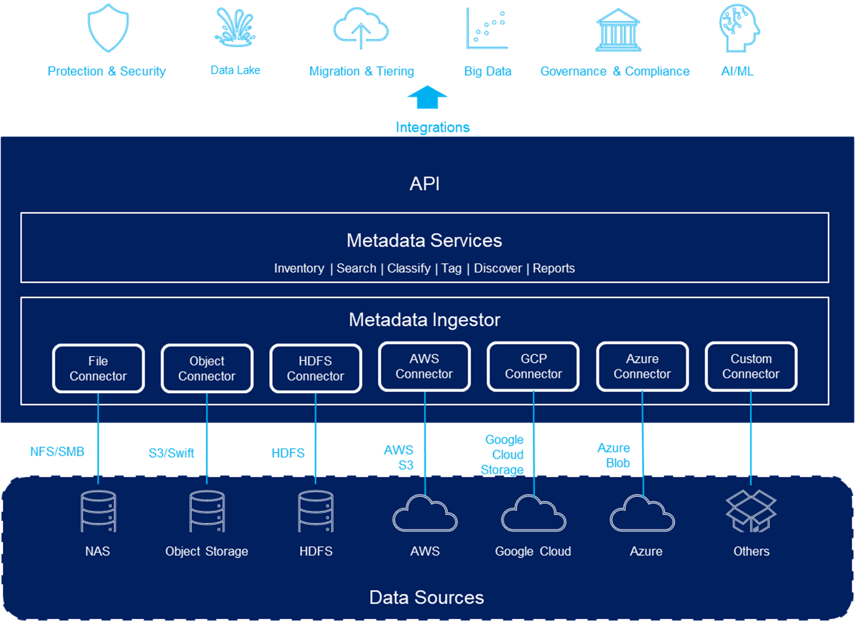

Slide 18
Where are we now?

Slide 19
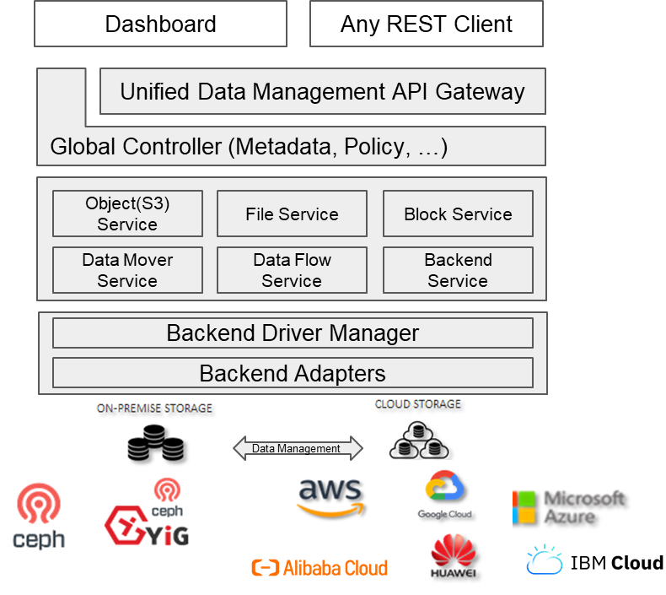
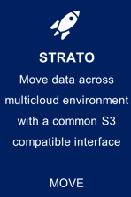

Cloud 1
SODA
Multi Cloud (Object, File, Block)
Cloud 2
Unified APIs
Cloud n
Different APIs
Unified multicloud API
S3 compatible
Support all major cloud vendors
Data migration
Data Lifecycle management
Hybrid data management for object storage (on-prem-cloud)
File/Block/Object
User Level Tiering Plan – Storage Service plan
Smart Archival
https://github.com/sodafoundation/strato

Slide 20
Crystal getting cut!
Crystal Project just started deriving s3 metadata management from SODA Strato
https://github.com/sodafoundation/crystal

Slide 21
Technology and Project Analysis, Gap, Requirements
Plan Next…
Architecture, Design
Crystal first cut Q2 2024

Slide 22

Together we can
shape Open Source Crystal!
discover unstructured data!
Give your requirements and inputs here!
https://github.com/sodafoundation/crystal/issues/9
http://bit.ly/soda-starter
https://www.sodafoundation.io/slack/

Slide 23

Borcelle
THANK YOU
https://bit.ly/soda-starter
www.sodafoundation.io
www.computer.org

